Slide 1
CONNECT FOUR gAME

Slide 2
Team Info:
احمد مجدى جمال محمد سكشن(2)
احمد شحاته عبدالله شحاته سكشن(1)
احمد شعبان محمد عبدالله سكشن(1)
عبدالرحمن على عطيه السحرتى سكشن(9)

Slide 3
Description
Connect Four is a two-player strategy game.
Played on a grid 6*7.
Each Player has its own coins color.
Red and yellow coins.
One player game (Player versus computer).

Slide 4
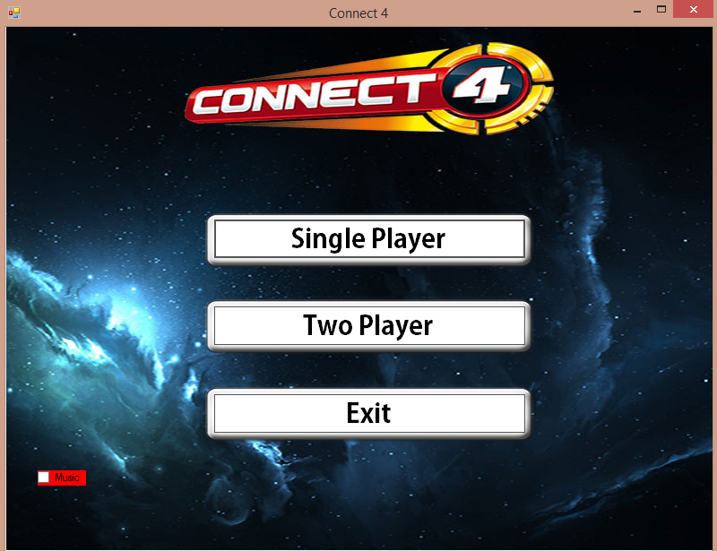
Game Play :

Slide 5
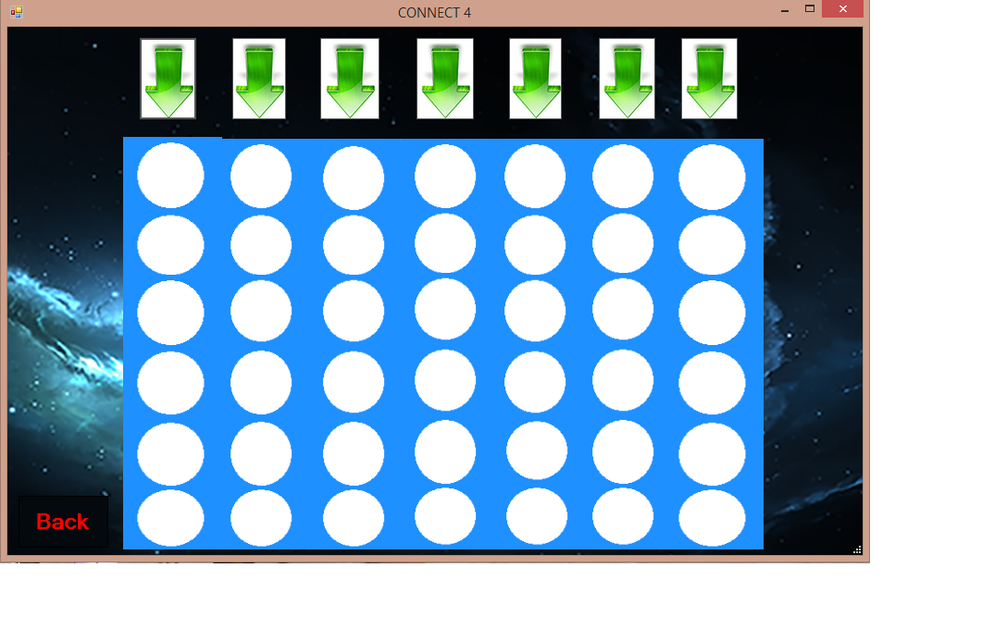
Game Play (cont) :

Slide 6
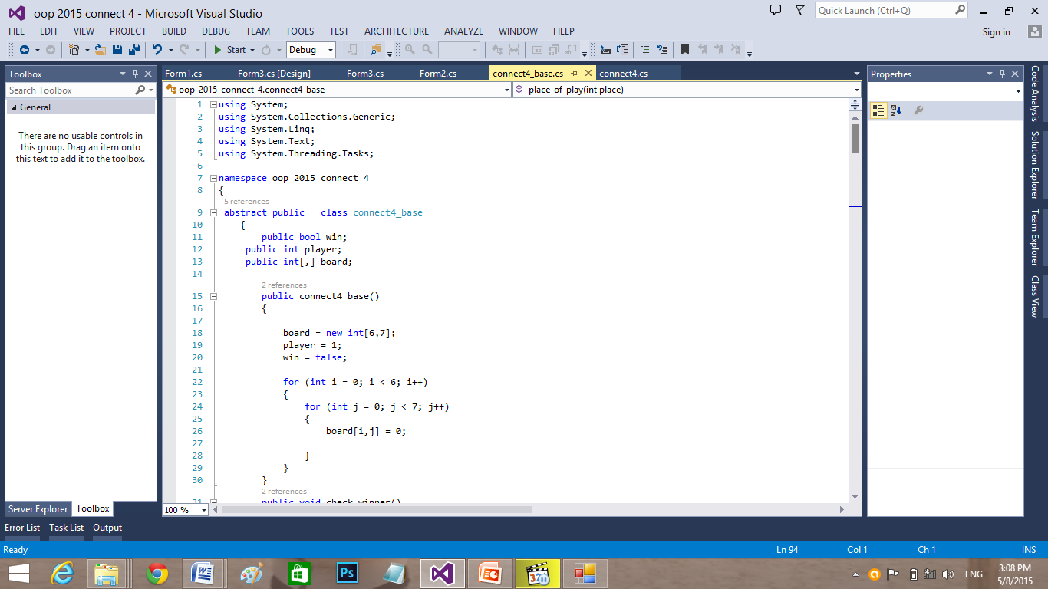
Game Code :

